Slide 1
MATLAB tutorial for PHYS 3007

Slide 2
Downloading and Installing MATLAB

Slide 3
The computers in the lab all have MATLAB already installed
As a student at Carleton University, you can download and install MATLAB on your personal computer (Windows, Mac, or Linux)
More information: https://carleton.ca/its/all-services/computers/site-licensed-software/matlab-students/

Slide 4
MATLAB basics

Slide 5
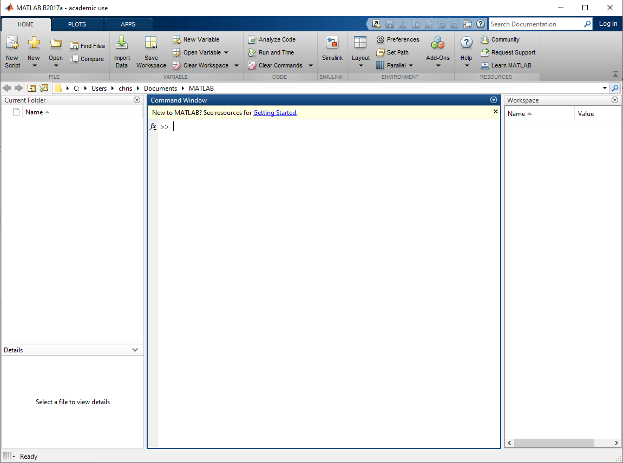
When you start MATLAB for the first time, the application has a toolstrip at the top and several windows below:
toolstrip
File explorer
Names and values of
variables which have
been assigned values
and haven’t been cleared
Command window
File details

Slide 6
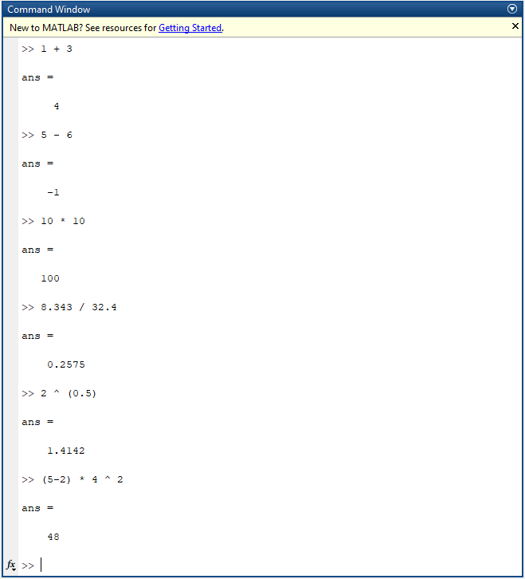
We will start with the command window, which is basically a powerful calculator
Expressions or commands are entered after the >> symbol on the last line of the command window
Here are some basic calculation examples:
Addition of two numbers
Subtraction of two numbers
Multiplication of two numbers
Division of two numbers
Exponentiation
More complicated expression

Slide 7
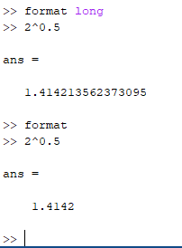
Notice that by default, the result is displayed with up to 4 digits after the decimal
The precision of the output can be increased to 15 digits after the decimal point by changing to ‘long format’ using the format function
You can return to the default format by running the format function by itself

Slide 8
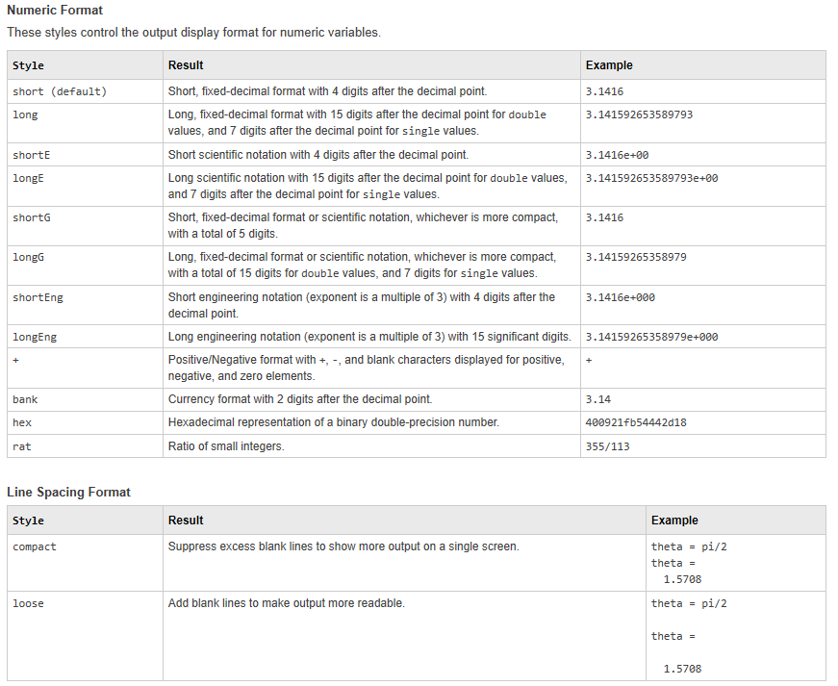
Here is a table of the different Numeric and Line Spacing formats in MATLAB (https://www.mathworks.com/help/matlab/ref/format.html)

Slide 9
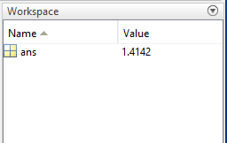
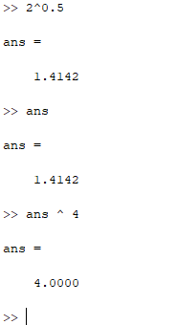
Also notice that after each expression is evaluated, the result is stored in a variable named ‘ans’
The value can be displayed by typing the name of the ans variable in the command window
We can use this variable to work with the result of the previous expression without typing out the number

Slide 10
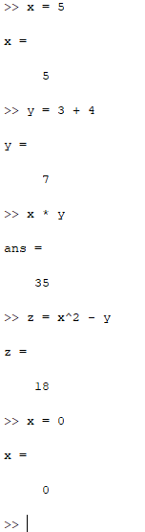
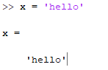
We can also assign values to our own variables and use them in expressions:
A string of text can be assigned to a variable too
The variable x has been overwritten with a new value

Slide 11
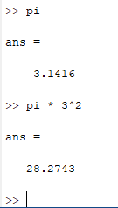
The constant π is readily available in MATLAB:

Slide 12
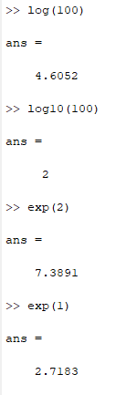
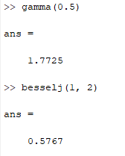
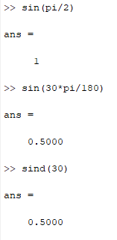
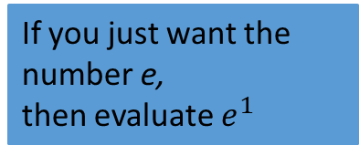
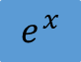
MATLAB includes most elementary and special math functions, for example:
Logarithm base e
Gamma function
Sine with argument
in radians
Logarithm base 10
Bessel function of the first kind of order 1, evaluated at x=2
$$e^{x}$$
Sine with argument
in degrees
If you just want the number e,
then evaluate $e^{1}$

Slide 13
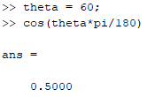
Note that each time a variable is assigned or an expression is evaluated, the result is displayed in the command window
You can suppress output by using a semicolon:
Output suppressed with semicolon
Output not suppressed

Slide 14
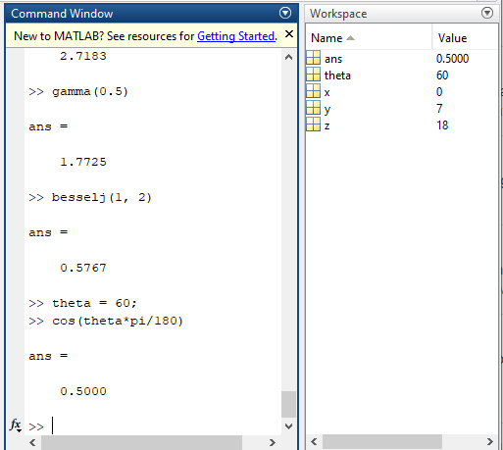
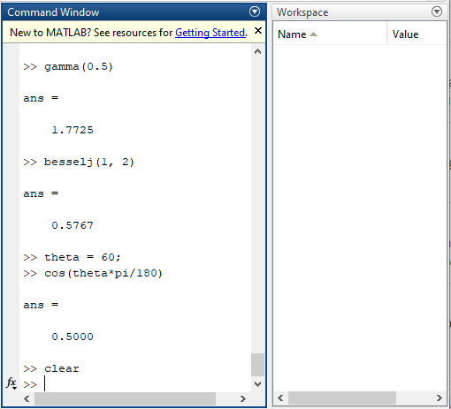
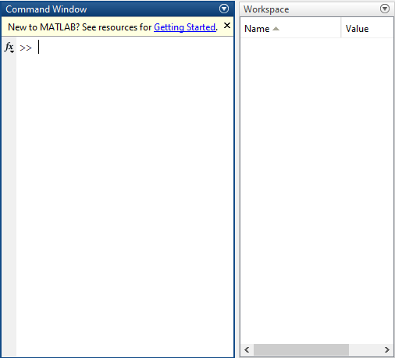
You can clear all variables in the workspace using the clear function
You can clear the command window using the clc function
(after running clc)

Slide 15
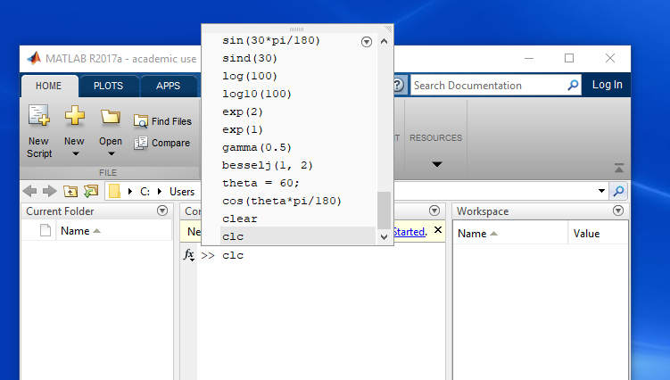
You can quickly access previously entered expressions by pressing the up arrow key on the keyboard when in the command window

Slide 16
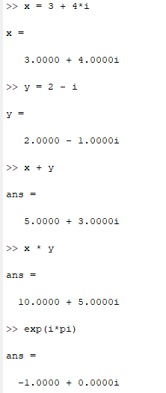
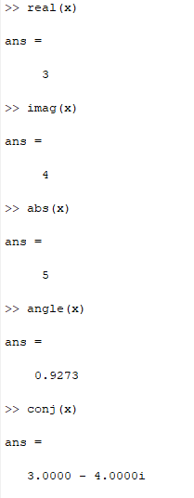
You won’t need them for most experiments but MATLAB can also do computations with complex numbers
The characters i or j are the imaginary unit (as long as you haven’t used them as variable names)
Real part
Imaginary part
Absolute value / modulus / magnitude
Argument / phase angle
Complex conjugate

Slide 17
Vectors and matrices

Slide 18
Things get a little more interesting when we start working with MATLAB arrays, or, vectors (1-dimensional arrays) and matrices (2-dimensional arrays)
A vector is essentially an ordered collection of a finite number of elements
It can be a row vector with m elements (i.e. a 1 x m matrix) or a column vector with n elements (i.e. a n x 1 matrix)

Slide 19
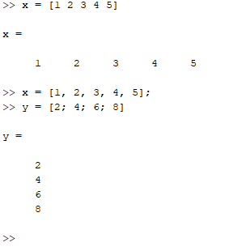
A row vector can be created by entering numbers within square brackets, separated by spaces or commas
A column vector can be created by entering numbers within square brackets, separated by semicolons
x is a row vector
y is a column vector

Slide 20
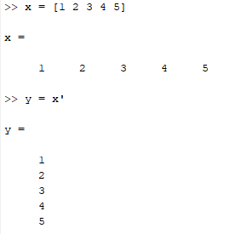
A vector can be transposed (i.e. a row vector changed into a column vector or vice versa) by using an apostrophe:
x is a row vector
y is a column vector

Slide 21
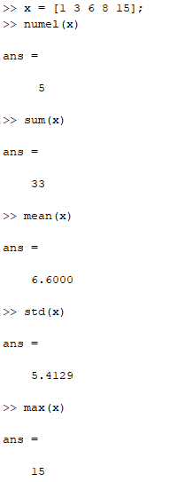
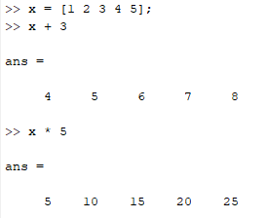
Some summary statistics for elements of a vector:
Adding/multiplying all elements of a vector by a scalar:
Number of elements
Sample standard deviation

Slide 22
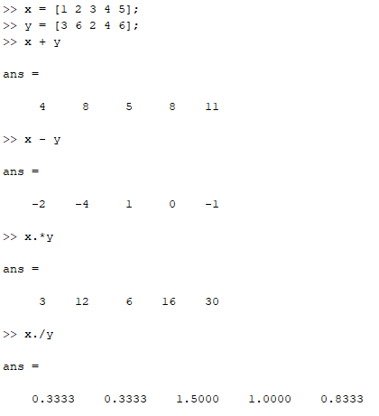
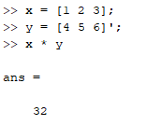
If two vectors have the same dimensions, they can be added, multiplied, etc. element-by-element:
* (as opposed to .*) is used for matrix multiplication (i.e. multiplication of a m x n matrix by a p x q matrix, for which n must equal p)
This can be used to compute the dot product of two vectors with the same number of elements. A row vector on the left must be multiplied with a column vector on the right
For element-by-element or pointwise multiplication and division, .* and ./ need to be used, respectively

Slide 23
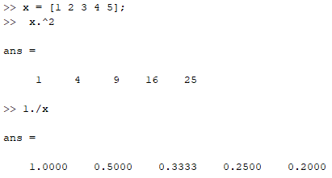
Raising each element of a vector to the same power and dividing a scalar by a vector (to yield of vector of the quotients) also require use of pointwise operators:

Slide 24
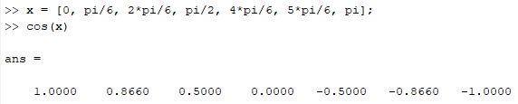
The math functions also accept vectors as arguments, outputting a vector consisting of the function evaluated at all the elements of the input vector:

Slide 25
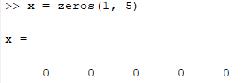
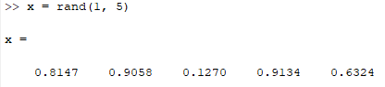
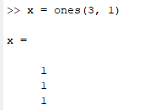
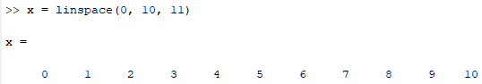
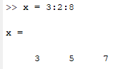
Manually creating vectors using square brackets is only done occasionally. Here are some other ways to create vectors:
Create an array of all zeros, with 1 row and 5 columns
Create an array of uniformly distributed random numbers in the interval (0, 1)
Create an array of all ones, with three rows and 1 column
Create a (row) vector with 11 elements linearly spaced from 0 to 10, inclusive
Create a (row) vector starting from 3 and going up to no more than 8, in steps of 2

Slide 26
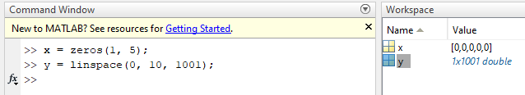
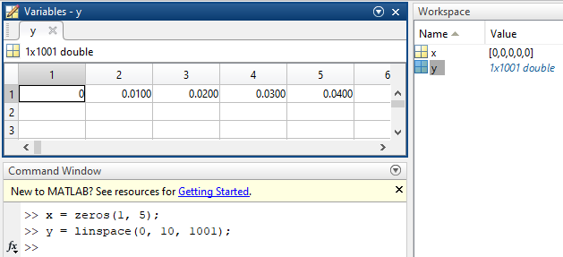
Note that if a vector is longer than just a few elements, the workspace will not display the individual elements but instead show the dimensions of the array and the type of its elements:
Double clicking a variable in the workspace will open the variables window, in which the elements of a large array can be examined

Slide 27
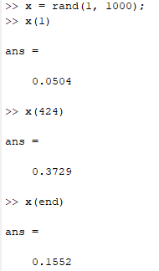
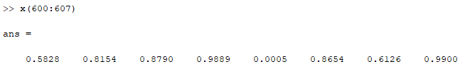
Individual elements of an array can be accessed using array indexing
NB: unlike many other programming languages, for which the first element of an array has index 0, in MATLAB the first element of an array has index 1
You can also access a range of elements in a vector using array slicing
Get the 1st element of x
Get the 424th element of x
Get the last element of x
Get a vector of all elements of x from 600 to 607 (inclusive)

Slide 28
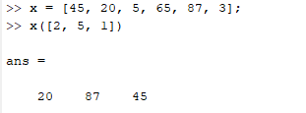
You can also access a range of elements in a vector using array slicing
600:607 is shorthand for 600:1:607, and is equivalent to the vector [600, 601, 602, 603, 604, 605, 606, 607], so slicing is just indexing using another vector
When indexing with a vector, a new vector is returned containing the elements located at the indices in the indexing vector
Get a vector of all elements of x from 600 to 607 (inclusive)
Get a vector of elements of x at indices 2, 5, 1 (in that order)

Slide 29
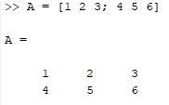
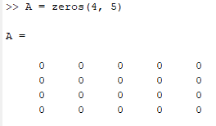
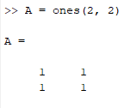
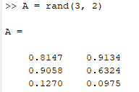
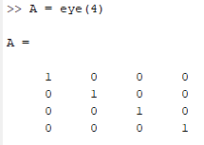
A matrix can be created by entering comma or space separated rows of numbers separated by semicolons within square brackets:
It can also be created with zeros, ones, rand:
You can create an n x n identity matrix:

Slide 30
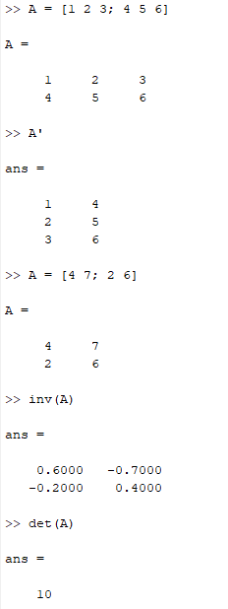
You can transpose a matrix, find its inverse (if it has one), find the determinant:

Slide 31
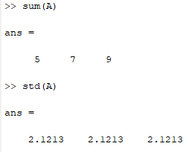
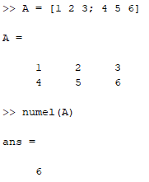
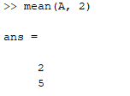
Determining the number of elements in a matrix is the done the same way as for a vector:
But the other summary statistics return a vector of the statistics for each column of the matrix:
Or you can get the statistics of each row:
mean(A, 1) is the same as mean(A)

Slide 32
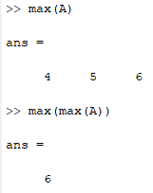
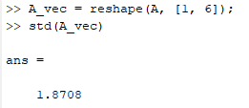
To get the sum, mean, max for all elements of a matrix, you can apply the functions two times:
With the standard deviation you need to be a little more careful since the standard deviation of the standard deviations of subsets is not equal to the standard deviation of the entire set. The matrix needs to be reshaped into a vector first. E.g.:

Slide 33

Math functions also accept matrices as arguments:

Slide 34

Matrices can be indexed and sliced
‘:’ means all rows (or all columns)
Get the element in row 2, column 1
Get all rows of column 3
Get all columns of rows 1 to 2

Slide 35


A matrix can be multiplied with a vector or a matrix multiplied with another matrix, as long as the dimensions are compatible

Slide 36
Scripts

Slide 37
Except when doing some simple one or two line calculations, entering commands one-by-one in the command window quickly becomes inefficient and tedious, for example, when you realize you need to make a change to a command you entered 10 lines ago
When performing more complex tasks, such as plotting or data analysis for your experiments, you will want to create a script, which is a file containing all of the commands you need to accomplish your task and in which you can edit any line or add new lines at any point. The commands are executed sequentially when the script is run.

Slide 38

To start a new script, click the New Script button in the toolstrip

Slide 39

A new Editor window will appear with a new Untitled script
A Save button will also appear in the toolstrip.

Slide 40

Let’s save the script before starting. You can choose the name and location of the script. MATLAB scripts are saved as .m files. I just called it example.m. You can see the newly saved file in the file explorer

Slide 41

Before getting to some commands, any text in the script appearing behind a % symbol will be a comment
The purpose of comments is annotate lines of code to explain what the code is doing in plain English.
This helps you to figure out what is going on when you go back and look at your code after two weeks, or for your TA to understand the code when attaching it to your lab report.
It may be a good idea to include comments at the top of each script stating your name, the date the script was created, when it was last modified, and a short description of what it does:

Slide 42

As a first example we will write a short and simple script
We will create two matrices and display the determinant of their product
The function fprintf() allows you to print strings with the values of variables in your code inserted into it, formatted however you like.
In this case the determinant is printed as a floating point number with two digits after the decimal point.
You can read more about fprintf() here:
https://www.mathworks.com/help/matlab/ref/fprintf.html
\n is the new line character

Slide 43

You can execute the script by clicking the green play button in the toolstrip
Any output from your script will be printed in the command window
Any variables created in your script will appear in the workspace
Note that the use of semicolons for output suppression is particularly useful in scripts. Any lines with a variable assignment or computation will give additional output to the command window when the script is executed, if a semicolon isn’t included.
You can try removing the semicolons from lines 10, 11, and 14 and running the script again.

Slide 44

Many people like to include commands at the start of a script for clearing the workspace and command window to give the script a ‘clean slate’ before doing anything else
Personally I don’t do this since I find it convenient sometimes to have variables produced in previously executed scripts hanging around, but it is up to you

Slide 45

Conditional statements in MATLAB – if block
Write ‘if’ followed by the logical expression to be evaluated
Include an ‘end’ statement at the end of the block
If the logical expression evaluates to True, the code inside
of the if block will be executed. The indent is not required.
~ is the NOT operator, && is the AND operator, || is the OR operator
The disp() function also prints a string or a variable value to the command
window. See https://www.mathworks.com/help/matlab/ref/disp.html
In this example, conditions 2 and 4 are True

Slide 46


Conditional statements in MATLAB – if-else block
Adding an else block to an if block allows alternative code to be executed if the logical expression evaluates to False
The ‘else’ statement is not followed by a logical expression to be evaluated
Output:

Slide 47


Conditional statements in MATLAB – if-elseif-else block
Adding elseif blocks in an if blocks allows for other conditions to be tested before resorting to the else block
Only the code in the first if/elseif block for which the condition is True (or the code in the else block if none are True) will be executed
Output:
The ‘elseif’ statement is followed by a logical expression to be evaluated
A final else block is not required

Slide 48


For loops
For loops in MATLAB iterate over the elements of a row vector
The loop variable one-by-one assumes the value of each element of the row vector, and executes some code using that value
Output:
Loop variable (can use
whatever name you want)
Use of loop variable
inside loop block
Loop vector
end statement

Slide 49



For loops
The loop vector can be a variable containing a vector (as shown on the previous slide) or the vector can be created right on the loop line
The colon notation for creating a vector is commonly used when looping over the integers in some range
1:10 is equivalent to 1:1:10
(Create a (row) vector starting from 1 and
going up to no more than 10, in steps of 1)

Slide 50


While loops
In a while loop, the while statement is followed by a logical expression to be evaluated
As long as the logical expression is True, the code in the while block will be executed. The expression gets re-evaluated each time the code in the block finishes executing
Output:
In this example, if x didn’t get incremented inside the while block, it
would always be less than 5 and we would be stuck in an infinite loop.

Slide 51
Reading data from files

Slide 52
For some experiments, the instruments will record data in a .txt, .csv, or some other file
If a camera or scanner is involved, the saved images constitute part of your raw data
We want to import this digital data into MATLAB, converting it into vectors or matrices in order to manipulate it
In other cases you might be manually changing a parameter and recording the output of some instrument (e.g. multimeter). In this case the data should be recorded in your log book, but you can also enter it into e.g. Microsoft Excel and save as a .csv or manually create vectors of the data in MATLAB, etc.

Slide 53

Let’s start with some code for reading in the data in the text file ‘gaus1.txt’
This file consists of 100 lines, each line having three numbers separated by some white space (a single space in this case)
Here are the first few lines (file contents viewed using Notepad):

Slide 54
Let’s start with some code for reading in the data in the text file ‘gaus1.txt’
This is simulated data that does not have any physical meaning. The first number in a row is the independent variable or x-axis data, the second number is the dependent variable or y-axis data, and the third number is the uncertainty on the y data
Note: the data in the file are not ordered by x value

Slide 55

To access the data in MATLAB, we need to determine the path of the file in the file system and enter it as a string
On Windows, you can determine the path by right-clicking on the file and selecting “Properties”. You can highlight and copy the Location. Note also the file name and file type

Slide 56

Start a new script and assign the location of the folder containing the data file and the file name to variables
Note: a trailing backslash has been added to the end of the file folder path
Note: the file extension ‘.txt’ has been added to the file name
The function strcat() concatenates two (or more) strings.

Slide 57

On the previous slide we constructed the absolute path of the file
If the data file or its parent folder is in the same location as the script file (which is the case for me, and can be seen in the MATLAB file explorer), we can use relative paths instead of absolute paths
data_from_file.m and the data file’s parent folder are in the same location
If you move the code+data together to a different computer, the code should just work if relative paths are used
Absolute paths are useful if the script and data are distantly separated in the file system for some reason

Slide 58

Having constructed the file path, let’s read in the data from the text file
To do this we can use the dlmread() function, passing the file path as an argument
After running the code, in the Workspace we see that the “value” of the variable into which we read in the data is a 100x3 double. This means it is a matrix with 100 rows and 3 columns of double-precision floating-point numbers

Slide 59

Again, we can inspect the contents of the matrix by double clicking on the variable name in the Workspace
The first column of the matrix contains the x data, the second column contains the corresponding y data, and the third column contains the corresponding y uncertainty data

Slide 60

What if the data has headers?
Sometimes the data file will include descriptive information in the first few lines, as is the case for ‘gaus1_with_headers.txt’
While helpful when viewing the file, we don’t want to read in the headers with the rest of the data

Slide 61

What if the data has headers?
Headers can easily be skipped by passing a few more arguments to dlmread()
The fourth argument is the number of columns to skip. Here we don’t want to skip any columns.
The first argument is the file path string
The second argument is the delimiter character (the character separating numbers in each row). In this case it is a space.
The third argument is the number of rows to skip in the file. Here there are 3 lines of header information.

Slide 62



What if the data is a .csv file? E.g. ‘gaus1.csv’ in the first figure
Then we can either use dlmread() with ‘,’ as the delimiter (second figure)
Or we can use the csvread() function (third figure)
By definition of csv, the
character separating
numbers in each row (the
delimiter) is a comma
Skip the first row
Skip the first row
Don’t skip any columns
Don’t skip any columns

Slide 63

After reading the data from a file, it is contained in a single variable as a matrix
It is helpful to break up the matrix so that there is one vector for each independent variable, one vector for the dependent variable, one vector the uncertainty on the dependent variable, and possibly vectors for the uncertainties on the independent variables
We can do this with matrix slicing:
x data is all rows of the first column
y data is all rows of the second column
y uncertainty is all rows of the third column

Slide 64

Often the data will be sorted by the independent variable
In this example the data are not sorted, but the three data vectors do correspond to each other, e.g. the y data and y uncertainty at index 4 are for the x data at index 4 (5.022192)
So let’s sort it by x data before doing anything else:
The sort function takes an array as an argument and returns two arrays. The first is the sorted input vector (which we reassign to the variable name x_data). The second contains what index each element of the input vector should have so that the vector is sorted
In lines 23 and 24 we use this vector of indices to index the vectors y_data and y_uncertainty, ordering them according the sorted x_data order … and then reassign these re-ordered vectors to the same variable names

Slide 65
Sometimes the data will be contained in multiple files, each file formatted the same way and need to be processed the exact same way.
We could just change the file_name variable and run the code for each file
But if there are many files, it will be more efficient to loop over the files (as long as they are stored in the same directory)

Slide 66

But if there are many files, it will be more efficient to loop over the files (as long as they are stored in the same directory)
For example, let’s loop over the three files multi1.txt, multi2.txt, and multi3.txt in the data folder
We first use the dir() function, passing in the string ‘data\multi*.txt’. The function returns a (in this case 3x1) vector of struct objects, with one struct for each file in data\ starting with “multi” and ending with “.txt” (the * is a wildcard). We store the vector of struct in the variable named “files”.

Slide 67


Each struct contains some information about one of the files that was matched. Double-clicking on the “files” variable in the workspace, we can see the fields for the struct object associated with each file
… and we can also see the names of the fields. A particular item of a struct is accessed using dot notation with the field name. In this case of a vector of structs, we need to index the vector too.
For example, accessing the number of bytes in the second file:

Slide 68

Since we are using the dir function to loop over files and open them one by one, we are mostly interested in the field “name” (and possibly the field “folder”, which contains the absolute path to the folder containing the file; but we already have the folder path in the variable “data_path”)
We could just loop over the elements of the ‘files’ vector directly, in which case the loop variable will assume each of the structs in the vector one by one, in which case we don’t need to do indexing:
The dir() function returns a column vector of structs, but we need to loop over a row vector

Slide 69

But often it is a good idea to loop over the indices of a vector rather than the elements of the vector directly:
After building the file path for each file in the directory, the rest of the code in the loop is the same as the single file code

Slide 70
If you are using MATLAB version R2019a or later, you can use the function readmatrix() instead of dlmread() to read in data from a file
The function is supposed to “just work” for .txt, .csv, and .dat files and also for .xls, .xlsx, and .ods files
E.g.
data = readmatrix(‘mydata.txt’);
data = readmatrix(‘mydata.csv’);
data = readmatrix(‘mydata.xlsx’, ‘NumHeaderLines’, 2); % this skips the first two rows

Slide 71
Reading in images
If your experiment data is in the form of an image (e.g. a .tif, .jpg, or .png file), it can be easily read into MATLAB for processing using the imread() function
The imread() function takes as an argument the filename of the image and outputs a 3-dimensional array
The first dimension of the array is the pixel rows, the second dimension is the pixel columns and the third is the image channels
A greyscale image will have one channel (and so the array is actually a 2-dimensional array). A standard colour image will have 3 channels (one for red, one for green, one for blue). There can be additional channels for transparency, etc.

Slide 72


Let’s read in the greyscale image “Gray_noise_1.tiff”
Since it is a greyscale image, the image is a 2D array with 365 rows and 366 columns of pixels. The data type is ‘uint8’, meaning the grey intensity for each pixel is an unsigned 8-bit integer (has a value from 0 to 255)

Slide 73

We can display the image using the imagesc() function:
By default, for greyscale or single channel images, MATLAB uses a colormap named parula, for which low values are blue and high values are yellow

Slide 74

We can change the colormap using the colormap() function. Let’s change it to a grey colormap
Also for greyscale or single channels image, it is useful to display a colorbar, which indicates the value each color corresponds to
The image also looks better if we make the width and height of the pixels the same (axis equal)

Slide 75

These are the predefined colormaps:

Slide 76


Next, let’s read in the 3-channel colour image ‘rgb_noise_2.tif’ and display it
For a 3-channel image, imagesc() will correctly display the full colour image
The image array is 3-dimensional: 358 rows x 358 columns x 3 channels.
8 bits per colour channel

Slide 77

We can extract the matrices of the individual channels using array indexing:

Slide 78

We can also, for example, take the mean over the third dimension to get one kind of measure of the intensity of the image

Slide 79
Plotting

Slide 80

plot() is the basic graph plotting function in MATLAB
The most basic way to use it is to pass two vectors (of the same size) to the function, the first vector being the x-axis data and the second vector being the corresponding y-axis data
As a first example, let’s plot a sine function. Let’s say it’s a voltage as a function of time with amplitude 20 V and a frequency of 1 Hz.
Let’s plot two cycles, from 0 to 2 seconds. To start, create an x-vector with 10 linearly spaced points from 0 to 2 and evaluate the appropriate sine function at those points

Slide 81

And then plot them:
By default, the plot function opens a new figure window and joins the points of the vectors in order with lines of some thickness and colour. Tick marks are drawn on all four sides and some automatic tick labels appear on the bottom and on the left. The axis limits are automatically set. There are no axes labels, titles, etc.

Slide 82

The sine wave looks jagged because we didn’t sample points densely enough
Instead of 10 points between 0 and 2 let’s try 1000 points:

Slide 83


Note that the second time we ran the plot function, a new figure window didn’t open. The new plot was made in the existing figure window (assuming you didn’t close it) and overwrote the content.
To open a new figure before plotting, you need to call the figure function
To plot two (or more) curves in the same figure window, just add more x and y vectors to the plot() call:

Slide 84

Or if you already have a figure window with a plot and you want to add another plot to the same axes, you can first call “hold on” and then call plot() again:

Slide 85


You can add a title and axes labels to a plot
The labels, title, etc. also support some TeX markup:

Slide 86

The line style, marker style, and colours of a curve can be modified by passing a LineSpec string as a third argument to the plot() function
The LineSpec string consists of one or two characters for the Line Style, one character for the Marker Style, and one character for the color
Here is the sine plot (with only 20 points), but as a dashed line with square markers, all red

Slide 87



Here are the possible characters for the LineSpec string:

Slide 88


Besides the LineSpec string, we can also specify properties of a curve by passing name-value pair arguments to the plot() function
For every property or option we want to set, we pass two more arguments at the end of the call to plot(), the first argument is a string specifying which property to change and the second is the value to set for that property
For example, explicitly set the LineStyle:
Or the marker symbol
Note: you can specify no line or no marker by passing ‘none’ as the value argument for either of these properties

Slide 89

We can use the Color property to pick a colour other than the 8 available using the LineSpec string, by passing either an RGB triplet vector or a hexadecimal colour code (in R2019a or later) as the value argument
For example, we make a curve viridian:

Slide 90
We can change the width of the line (default is 0.5)
We can specify at which indices of the x data vector (or y data vector) a marker should be displayed by passing a vector of indices
For example, we can plot a line with 1000 points but only show a marker for every 50th point

Slide 91

We can specify the marker edge colour, marker face colour, and marker size (default is 6)
If a line is too long, you can break it up using …

Slide 92

Other than changing the curve appearance and labels of a plot, we can also change the axes properties
A good way to get control of the axes properties is to create a variable containing the axes object in which a curve is plotted
This will create an axes object in the most recently accessed figure window (the so-called “current figure”). If that figure already had an axes object, it will now have two (or more).
If no figure windows have been created yet, calling axes will create a new figure object and that figure will be the parent of the newly created axes.

Slide 93

Just as we can store an axes object in a variable, we can also store a figure object in a variable, which is useful if we want to specify the figure in which we want to create the axes
Specify fig1 as the parent figure for the new axes object

Slide 94

Before proceeding to changing the axes properties of a plot, let’s add some code to read in the data from gaus1.txt and gaus2.txt (and then plot them)

Slide 95

When we call the plot function, the curve is plotted in the current axes (either overwriting an existing plot in the current axes or adding the new plot without overwriting existing plots, depending if hold on was called)
Just as we can specify the parent figure of a new axes object, we can specify the parent axes of a new plot object, and also store the new plot object in a variable. Pass the axes object as the first argument to plot():
You can also specify for which axes you want to set the xlabel/ylabel/title
Let’s pretend the gaus data were intensity vs position measurements

Slide 96

To change axes properties, the generic formula is
ax1.PropertName = PropertyValue; (if your axes object is in the variable ax1)
Most commonly we will be adjusting the axes limits:

Slide 97

It is good practice to turn the Box on (have axes lines and ticks on all four sides)

Slide 98


We can pass a vector specifying where the x ticks or y ticks should be:
The ticks can point ‘in’ or ‘out’ or in ‘both’ directions:

Slide 99


It is possible to rotate tick labels and to turn on minor ticks:
You can change the length of minor and major tick marks, passing a two element vector (default lengths are 0.01 and 0.025)
For tick label rotation, the property value is an angle in degrees

Slide 100

You can add grid lines:
And also change the GridLineStyle, GridColor, GridAlpha (transparency), or turn on minor grid lines

Slide 101

You can change the font family and font size:
You can also set the font weight (‘normal’ or ‘bold’) and the font angle (‘normal’ or ‘italic’)

Slide 102
The full listing of axes properties can be found here:
https://www.mathworks.com/help/matlab/ref/matlab.graphics.axis.axes-properties.html

Slide 103

When you have more than one curve on the same plot, you need to indicate which curve is which
We can do that with a legend:
You can use a Name-Value pair to specify the Location of the legend
You can leave out this first argument to place the legend on the current axes
Pass in label strings in the order that plots were added to the axes

Slide 104

Notes on identifying curves on a plot:
It is a bad idea to simply use colour to distinguish curves. When the figure is printed with a black and white printer or if the reader is colour blind, the curves may be indistinguishable
Vary the line width or line style (in addition to the colour, if you wish):

Slide 105

Notes on identifying curves on a plot:
Rather than using a legend, it may be better to just label the curves directly
It is possible use the annotation() function in MATLAB but it is a little tricky because you need to determine the normalized figure coordinates at which to start and end the annotation
It may be easier to export the figure to MS Paint or to Inkscape if you want to add labels

Slide 106

Plotting with error bars
If you want to make a plot with error bars, then use the errorbar() function instead of the plot() function
For plotting with error bars on y only, pass a third vector containing the uncertainty for each point

Slide 107

Plotting with error bars
For plotting with error bars x and y, you need to pass four additional vectors (negative y error, positive y error, negative x error, positive x error). The negative and positive error bars need not be the same, but they are in the following example:

Slide 108

Logarithmic axes
You can change the axes properties XScale and YScale from ‘linear’ to ‘log’ or you can use the functions semilogx(), semilogy(), or loglog() instead of plot():

Slide 109

Logarithmic axes
You can change the axes properties XScale and YScale from ‘linear’ to ‘log’ or you can use the functions semilogx(), semilogy(), or loglog() instead of plot():

Slide 110

Logarithmic axes
You can change the axes properties XScale and YScale from ‘linear’ to ‘log’ or you can use the functions semilogx(), semilogy(), or loglog() instead of plot():
Generate 100 logarithmically spaced points from 10^1 to 10^3

Slide 111

Saving a figure to a specific file format
Use the savas() function to save a figure. The first argument is the figure object, the second argument is the file path (including extension)
Save the gaus data plots to a .png file named ‘gausdata.png’ (in the same directory as the script)

Slide 112
Curve fitting

Slide 113

As a first example we will fit a Gaussian function to some Gaussian-shaped data (gaus1.txt)
It is common that we have some Gaussian-shaped data and want to find the centre of the Gaussian, using the width of the Gaussian as the uncertainty on the centre location
We usually disregard the individual uncertainties on the measured data points when doing this
First, get the data into MATLAB:

Slide 114

To do the fit, we use the fit() function:
The form of the ‘gauss1’ model is y = a*exp(-((x-b)/c)^2)
Other models can be found here https://www.mathworks.com/help/curvefit/list-of-library-models-for-curve-and-surface-fitting.html#btbcvnl
Or you can define your own model
Note: the fit function expects column vectors. If you have row vectors, you need to transpose them first
Independent variable vector
Dependent variable vector
Single Gaussian fit model

Slide 115

By default, the fit function runs some algorithm to minimize the following expression:
$$\sum_{i=1}^{N}{{\left(f\left(x_{i}\right)− y_{i}\right)}^{2}}$$
Where N is the number of data points, the $x_{i}$ are the values of the independent variable vector and the $y_{i}$ are the values of the dependent variable vector.
$f\left(x_{i}\right)$ is the model function evaluated at each value of the dependent variable.
The expression is minimized with respect to the parameters, i.e., Matlab finds the values of the parameters in the fit function that minimize the expression.
This is known as Least Squares, since it finds the minimum sum of squares of the difference between the measured dependent variable values and the model calculated dependent variable values

Slide 116

We can view the contents of the fit output by entering the variable in the command window
We see the form of the fit model and the parameters of the fit (along with some 95% confidence bounds, which we will ignore here)
The parameter b1 is the location of the centre of the Gaussian. The parameter c1 is proportional to the width. The width that we want is the standard deviation, which is equal to c1/sqrt(2)

Slide 117

We can access the parameter values from the fit object variable using dot notation
Let’s plot the data along with the fitted Gaussian to visually inspect the quality of the fit
Again, let’s pretend the gaus data were intensity vs position measurements
The fit looks all right

Slide 118
The results of the fit are:
Centre of the bump is at b1 = 1.9953 cm
The width of the bump is c1/sqrt(2) = 0.4988 cm
Using the standard deviation of the Gaussian as the uncertainty of the bump location, we conclude that the centre of the intensity bump is at
(2.0 +/- 0.5) cm

Slide 119
Second example: let’s fit a curve to some data, taking into account the uncertainties on the data points. We will use chi-squared minimization as a fitting procedure
Let’s fit a curve to the data in malus3.txt
The expected shape is sine squared
Here we don’t have any uncertainties on the x variable. If there are uncertainties on x, and they are much smaller than the uncertainties on the y variable, they can be ignored
(more precisely, if variations in x on the order of σ_{x} result in variations in the measurement of y much smaller than σ_{y}, then we can neglect σ_{x} when fitting)
Since we have some control over the independent variable, it is often the case that σ_{x} will be relatively small and can be neglected when fitting

Slide 120

First, read the data into MATLAB and plot it:

Slide 121
The form of the function that we want to fit is a generic sine squared with four parameters: f(x) = a₁ * sin²(a₂*x + a₃) + a₄
where a₁ encodes the amplitude, a₂ encodes the frequency information, a₃ encodes the phase shift, and a₄ encodes the DC shift
Let’s again assume that the data is intensity (in W/m^2) vs position (in cm)
Since the variables have units, some of the parameters have units too. a₁ has units W/m^2, a₂ has units rad/cm, a₃ has units rad, and a₄ has units W/m^2

Slide 122

To do the fit, we introduce the χ² function (“chi-squared”; χ is written out as “chi” and pronounced as “kai”):
$${\text{χ}}^{2}=\sum_{i=1}^{N}{\frac{{(y_{i}−f(x_{i};a_{1}, …, a_{m}))}^{2}}{σ_{i}^{2}}} ,$$
Where N is the number of data points being fitted to, the x_{i} and y_{i} are the values of the independent and dependent variables, respectively, for each data point, and the σ_{i} are the uncertainties on the y values for each data point. $a_{1}, …, a_{m}$ are the m parameters of the fit function

Slide 123

In our case of a sine squared fit function,
$${\text{χ}}^{2}=\sum_{i=1}^{N}{\frac{{(y_{i}−a_{1}\sin^{2}\left(a_{2}x_{i}+a_{3}\right){−a}_{4})}^{2}}{σ_{i}^{2}}} ,$$
The x_{i} are the positions, the y_{i} are the measured intensities, and the σ_{i} are the uncertainties on the intensities
Performing the fit means finding the values of the parameters for which the value of χ² is minimized. Call these values $a_{1}^{∗}$, $a_{2}^{∗}$, …
The method of curve fitting by minimizing χ² is a form of Weighted Least Squares (with weights 1/$σ_{i}^{2}$)

Slide 124


Before proceeding to find the values of the parameters of the fit function that minimize χ², since the measurements have uncertainties, the fit parameters will have uncertainties too.
The uncertainties on the parameters are determined as follows:
Form the curvature matrix of the χ² function at its minimum
Then, the inverse of the curvature matrix is the covariance matrix
$$α_{ij}={\left.\frac{1}{2}\frac{∂^{2}χ^{2}}{∂a_{i}∂a_{j}}\right|}_{\vec{a}={\vec{a}}^{∗}}$$
For m parameters, this is an m x m matrix
Where $\vec{a}$ is the vector of parameters and ${\vec{a}}^{∗}$ is the vector of best fit values for the parameters
$$ε_{ij}={\left(α_{ij}\right)}^{−1}$$

Slide 125

$ε_{ij}$ is also an m x m matrix (or in our case, a 4x4 matrix since the sine squared fit has four parameters)
$ε_{ii}$ is the variance of fit parameter $a_{i}$, and so $\sqrt{ε_{ii}}$ is the uncertainty of parameter $a_{i}$
$ε_{ij}$ for i ≠ j is the covariance of parameters $a_{i}$ and $a_{j}$
$ε_{ij}$ = $ε_{ji}$ (the covariance matrix is symmetric)

Slide 126


Finding the parameter values that minimize χ² for our chosen fit model as well as the covariance matrix is relatively straightforward in Matlab. You just need to include the weights in the fit function call
If a weights vector, $w_{i}$, is passed to the fit function (using a name-value pair with name ‘Weights’), the following expression is minimized:
This time we will define a custom fit model rather than use a built-in fit model
$$\sum_{i=1}^{N}{{w_{i}\left(f\left(x_{i}\right)− y_{i}\right)}^{2}}$$

Slide 127



You can provide a vector of initial guesses for the fit parameters by using a name-value pair with name ‘StartPoint’.
Sometimes it helps to guess values that are pretty close to assist the fitting to settle at the right values.
You may want to verify the order of the parameters for the start point vector by executing coeffnames(ft) in the command window.
Define fittype for custom model
Fit object (contains parameter values from the fit)
Objects containing more fit details
$$α=J^{T}J$$
y_err is the vector of σ_{y,i}. The least squares weights need to be 1/$σ_{y,i}^{2}$
Weighted Jacobian matrix of model fit

Slide 128

Weighted Jacobian matrix of model fit
$$J_{ij}=\sum_{k}{{\left.W_{ik}^{1/2}\frac{∂f(x_{k};\vec{a})}{∂a_{j}}\right|}_{\vec{a}={\vec{a}}^{∗}}}$$
with
$$W_{ii}^{1/2}=\frac{1}{σ_{i}}$$
$W_{ij}^{1/2}=0,$for i ≠ j
Exercise: show $α=J^{T}J$

Slide 129

Aside: how I picked the start point
The standard sine squared curve oscillates from 0 to 1 and has a period of π.
As can be seen on the plot a few slides ago, the curve oscillates from about -1 to 1 and has a period of about π
Therefore we need to scale the amplitude by 2 ($a_{1}$=2), shift the curve down by 1 ($a_{4}$=-1), and don’t do any frequency scaling ($a_{2}$=1)
The standard sine squared curve has a minimum at x=0. In the plot it looks like the curve is leading the standard curve by a quarter period, i.e. the phase shift is π/4 ($a_{3}$=π/4)

Slide 130



Running the code, we can obtain the parameter best fit values and the covariance matrix
That is, $a_{1}=2.017$ W/m^2, $a_{2}=0.9994$ rad/cm, $a_{3}=0.8400$rad, $a_{4}=−0.8006$W/m^2
$σ_{a_{1}}=\sqrt{7.6455e−4}=0.02765$ W/m^2, $σ_{a_{2}}=\sqrt{1.4762e−5}=0.00384$ rad/cm, $σ_{a_{3}}=\sqrt{2.1258e−4}=0.01458$ rad, $σ_{a_{4}}=\sqrt{2.6279e−4}=0.01621$ W/m^2
Or, $a_{1}=(2.017±0.028)$ W/m^2, $a_{2}=(0.999 ±0.004)$ rad/cm, $a_{3}=(0.840 ±0.015)$ rad, $a_{4}=(−0.801 ±0.016)$ W/m^2

Slide 131

Let’s plot the fit with the data

Slide 132

Having found the fit parameters, we can compute, for example, the intensity at an arbitrary position
Something to be aware of, however:
Suppose we wanted to evaluate the intensity at 4.2 cm
This is of course f(4.2) = a₁ * sin²(a₂*4.2 + a₃) + a₄ = 1.0106 W/m^2
To calculate the uncertainty, you might try to use the usual error propagation formula
$$σ_{f}^{2}=\sum_{i=1}^{m}{σ_{a_{i}}^{2}{\left.{×\left(\frac{∂f}{∂a_{i}}\right)}^{2}\right|}_{\vec{a}={\vec{a}}^{∗}, x=4.2}}$$
But the parameter covariances are non-zero so the more general formula needs to be used:
$$σ_{f}^{2}=\sum_{i,j}{{\left.ε_{ij}×\left(\frac{∂f}{∂a_{i}}\frac{∂f}{∂a_{j}}\right)\right|}_{\vec{a}={\vec{a}}^{∗}, x=4.2}}$$
where $ε_{ij}$ is the parameter covariance matrix

Slide 133


Based on the plot two slides ago, the fit looks okay but how can we quantify the goodness of fit?
First, let’s compute the value of the χ² function at its minimum (i.e. for which the fit function uses the best fit parameter values):
It is 121.4485
We can actually also access the value of the χ² function at its minimum from the gof variable:

Slide 134

Next, if the hypothesized fit model we selected is the correct hypothesis, the minimum value of the χ² function, ${\text{χ}}_{min}^{2}$, evaluated for data sets collected for repeated experiments should follow the chi-squared probability distribution:
$$f\left(x;ν\right)= \frac{1}{2^{\frac{ν}{2}}Γ\left(\frac{ν}{2}\right)}x^{\frac{ν}{2}−1}e^{−x/2}$$
where $ν$ (Greek letter nu) is the number of degrees of freedom
$ν$ = no. of data points – no. of parameters
In our example, $ν=100−4=96$
The number of degrees of freedom can also be accessed from the gof variable (gof.dfe)

Slide 135

What we do is calculate the probability, if our hypothesis is correct, of getting a ${\text{χ}}_{min}^{2}$ value greater than or equal to the one that we got
This probability is known as the p-value, and is computed as:
$$p=\int_{{\text{χ}}_{min}^{2}}^{∞}{f\left(x;ν\right)dx}$$
We can check if our p-value is less than some selected significance level, often taken as 0.05
If p < 0.05, then we reject the hypothesis that our chosen model is the correct. Otherwise, we fail to reject the hypothesis (that’s the strongest thing we can say; we are unable to conclude that the hypothesis is the correct one).

Slide 136

But getting a large p-value (i.e. >0.95) is also non-ideal. It means that we are overfitting the data (i.e. too many parameters in the fit model) or that our measurement uncertainties are too big
On average, we expect the p-value to be about 0.5 if the hypothesis is correct
Alternatively, the chi-squared distribution has an expectation value of $ν$, so if our calculated ${\text{χ}}_{min}^{2}$ ≈ $ν$, then we say the fit is ‘good’
${\text{χ}}_{ν}^{2}=\text{χ}\text{2}/ν$ is called the reduced chi-squared statistic. Based on the above, for a ‘good’ fit it should be about equal to 1
Typically it is more informative to report the p-value, the ${\text{χ}}_{min}^{2}$ and $ν$, rather than simply reporting the value of ${\text{χ}}_{ν}^{2}$

Slide 137


Calculating the p-value is also straightforward in Matlab:
For our fit, we get p=0.0407, ${\text{χ}}_{ν}^{2}=1.2651$
The p-value is below 0.05. It looks like many of the data points are more than one std dev away from the curve. Maybe we need to retake the data a little more carefully or maybe our uncertainties on the intensities were slightly underestimated. Or maybe we were just unlucky.

Slide 138

Third example: let’s determine the radii of the fringes in the image ‘rgb_noise_2.tif’
First, read the image data into MATLAB and average over the 3 colours channels to get an intensity matrix:

Slide 139
Next, since the image is circularly symmetric about the centre, we can just work with a horizontal profile through the middle of the fringe pattern
But since the image is a bit noisy, let’s take a narrow horizontal strip near the centre (say, 10 rows of pixels high) and average over the rows to smooth out the noise a little
If the strip is sufficiently narrow, the rings are approximately vertical over the strip and their curvature shouldn’t affect the average over the rows

Slide 140

We can grab a strip from the intensity matrix using array slicing
After averaging over rows, let’s plot the profile

Slide 141
In the plotted profile we see 12 bumps, one for each of the left and right sides of the 6 full rings seen in the image
We will determine the location of the centre of each bump by assuming the bumps are Gaussian in shape and fitting a Gaussian to each one, one at a time
I decided to semi-automate this process as follows:

Slide 142


In the plot of the intensity profile, use the cursor tool to find an x-coordinate for the left and right ends of each bump
For example, for bump 7 I’ll use x=223 and x=238 for the left and right ends, respectively

Slide 143

Create one 12-element row vector for all of these left-end coordinates and another row vector for the right-end coordinates
Also, instantiate 12 element row vectors with zeros that will hold the centres and widths of the 12 bumps (the elements will be determined one-by-one in a loop)

Slide 144


Next, create a four-parameter Gaussian fittype and loop over all the bumps, fitting the Gaussian to each one at a time

Slide 145


Now, the first 6 bumps are from the left ends of the fringes (from largest radius fringe to smallest radius fringe) and the last 6 bumps are from the right ends of the fringes (from smallest radius fringe to largest radius fringe)
Create two vectors, one for the centres of the left sides of the fringes and one for the centres of the right sides of the fringes (from smallest radius fringe to largest radius fringe)
The radius is just half the distance between the right and left sides of a fringe
These radii are in units of pixels. In an experiment you would want to convert this to a physical distance in, for example, cm
You would also need to compute the uncertainties on the radii

Slide 146

Fourth example: read in and plot the data in ‘PMT1.txt’:

Slide 147
We will fit one line the rising region in the middle and one line to the flat region on the right and find the intersection point of these lines
We need to determine the range of indices for the two regions
First use the cursor tool to determine the x-coordinates of bounding points:
Rising region: x = 8.75 to x = 10.99. Flat region: x = 13.74 to x = 19.76

Slide 148




Rising region: x = 8.75 to x = 10.99. Flat region: x = 13.74 to x = 19.76
Then double click on the x_data variable in the workspace to determine the indices of these points:
Rising region: indices 40 to 53. Flat region: indices 67 to 100

Slide 149

Perform two separate linear fits, one in the rising region and one in the flat region
The form of ‘poly1’ is y = p1*x + p2

Slide 150


So the equations of the two lines are
y = 0.8134*x – 7.1145 & y = 0.0233*x + 2.0086
Determine the intersection point:
For an actual experiment, you would need to complete the calculations for the uncertainty on this point

Slide 151

Plot the lines and the intersection point with the data

Slide 152
Extra

Slide 153

Graphical method for determining uncertainties on fit parameters – 1 parameter
The graphical method for determining the uncertainty on a single-parameter fit will be demonstrated using the 1 parameter exponential data.
Read in the data and plot it:

Slide 154



Graphical method for determining uncertainties on fit parameters – 1 parameter
Perform the fit using chi-squared minimization. The function model is y = a*exp(-a*x):
The fit gives a parameter value of a = 0.5078
There was only one fit parameter so the covariance matrix is just the variance of that one parameter.
The uncertainty on a is
σ_{a} = 0.0151
The value of the ${ χ}^{2}$ function at its minimum is 25.8118

Slide 155



Graphical method for determining uncertainties on fit parameters – 1 parameter
The graphical method does not make use of the Jacobian or curvature matrix. We just computed them to compare the resulting parameter uncertainty with the following:
We will plot the $χ^{2}$ function, keeping all of the x, y, and σ_{y} data points fixed and varying only the parameter value. Plot the function in the vicinity of the best fit parameter value
Notice: the ${ χ}^{2}$ function is at a minimum for the parameter fit value a = 0.5078

Slide 156





Graphical method for determining uncertainties on fit parameters – 1 parameter
The uncertainty on the parameter value is the difference between the parameter value at which $χ^{2}=χ_{min}^{2}+1=26.8118$ and the parameter value at which $χ^{2}=χ_{min}^{2}=25.8118$ (a = 0.5078)
So plot the line $χ^{2}=26.8118$ and inspect at which value of a it intersects the $χ^{2}$ curve:
$χ_{min}^{2}+1=26.8118$
(zoom in)
$$χ_{min}^{2}+1$$
$$σ_{a}$$
Looks like $χ^{2}=26.8118$ at a = 0.523

Slide 157


Graphical method for determining uncertainties on fit parameters – 1 parameter
The uncertainty on the parameter value is the difference between the parameter value at which $χ^{2}=χ_{min}^{2}+1=26.8118$ and the parameter value at which $χ^{2}=χ_{min}^{2}=25.8118$ (a = 0.5078)
So $σ_{a}=0.5230−0.5078=0.0152$
This is pretty much the same value
as we found with the curvature matrix
method.
(zoom in)
Looks like $χ^{2}=26.8118$ at a = 0.5230

Slide 158
Graphical method for determining uncertainties on fit parameters – 1 parameter
This graphical method is a good approximation of the curvature matrix method for finding the parameter uncertainty
Exercise: show why the graphical method works

Slide 159

Graphical method for determining uncertainties on fit parameters – 2 parameters
The graphical method for determining the uncertainty on a two-parameter fit will be demonstrated using the 2 parameter exponential data.
Read in the data and plot it

Slide 160





Graphical method for determining uncertainties on fit parameters – 2 parameters
Perform the fit using chi-squared minimization. The function model is y = b*exp(-c*x)
The fit gives parameter values b = 0.3962
c = 0.2833
The uncertainties are
σ_{b} = 0.0125
σ_{c} = 0.0139
The value of the ${ χ}^{2}$ function at its minimum is 13.1281

Slide 161



Graphical method for determining uncertainties on fit parameters – 2 parameters
We will plot the $χ^{2}$ function, keeping all of the x, y, and σ_{y} data points fixed and varying both parameters. Plot the function as a surface in the vicinity of the best fit parameter values
Notice: the ${ χ}^{2}$ function is at a minimum at the best fit parameter values
Since this is extra material, you can learn how to use surf() and meshgrid() here:
https://www.mathworks.com/help/matlab/ref/surf.html
https://www.mathworks.com/help/matlab/ref/meshgrid.html

Slide 162



Graphical method for determining uncertainties on fit parameters – 2 parameters
Now, restrict the z-axis range to be between $χ_{min}^{2}$ and $χ_{min}^{2}+1$, and view the surface looking straight down:
The result is an ellipse. At the centre of the ellipse, the chi-squared function has the value $χ_{min}^{2}$. The edge of the ellipse is where the chi-squared function is equal to $χ_{min}^{2}+1$.

Slide 163


Graphical method for determining uncertainties on fit parameters – 2 parameters
The uncertainties on the parameter values is determined as indicated in the figure:
That is, we find the distances between the ellipse tangents that are perpendicular to the parameter axes and the axis perpendiculars that go through the centre of the ellipse
$$σ_{c}$$
$$σ_{b}$$

Slide 164

Graphical method for determining uncertainties on fit parameters – 2 parameters
At the centre of the ellipse, b = 0.3962 and c = 0.2833 (best fit values)
At the tangents, b = 0.4087 and c = 0.2975
So $σ_{b}=0.4087−0.3962=$ 0.0125 and $σ_{c}=0.2975−0.2833=$ 0.0142
These values are very close to those determined using the covariance matrix method

Slide 165

Graphical method for determining uncertainties on fit parameters – 2 parameters
If there was no covariance between parameters b and c then the ellipse would not be tilted and we could determine the uncertainties by fixing e.g. c at its best fit value, plotting chi-squared vs b, and finding the difference between b values where chi-squared equals $χ_{min}^{2}$ and $χ_{min}^{2}+1$
If there is covariance, this simpler method would give uncertainties on b and c that are too small
If there are three or more parameters, you would need to find tangent hyper planes to a hyper ellipse

